Slide 1
BookBlend
Web Development Project

Slide 2
Group - 10
Group Members :
Aniruddh Korturti–(IIT2023007)
Rishabh Gupta – (IIT2023025)
Shilpi Kumari – (IIT2023045)
Gunjan Thakur –(IIT2023106)

Slide 3
Project Overview:
“BookBlend is a web platform designed for book enthusiasts.
Features include book browsing, cart management, user registration, and an admin dashboard for book management.”

Slide 4
Languages & Technologies Used:
Backend: PHP
Frontend: HTML, CSS, JavaScript
Database: MySQL

Slide 5
Key Features:
Facilitate book browsing and purchasing for users.
Enable user registration and account management.
Manage book inventory, including adding new books, editing existing listings, and removing books . User profile management, including updating personal information and viewing order history.
BookBlend offers a user-friendly interface with robust backend functionalities, ensuring a smooth and engaging experience for both administrators and users.
Contact page allowing users to send messages or inquiries to the site administrator.

Slide 6
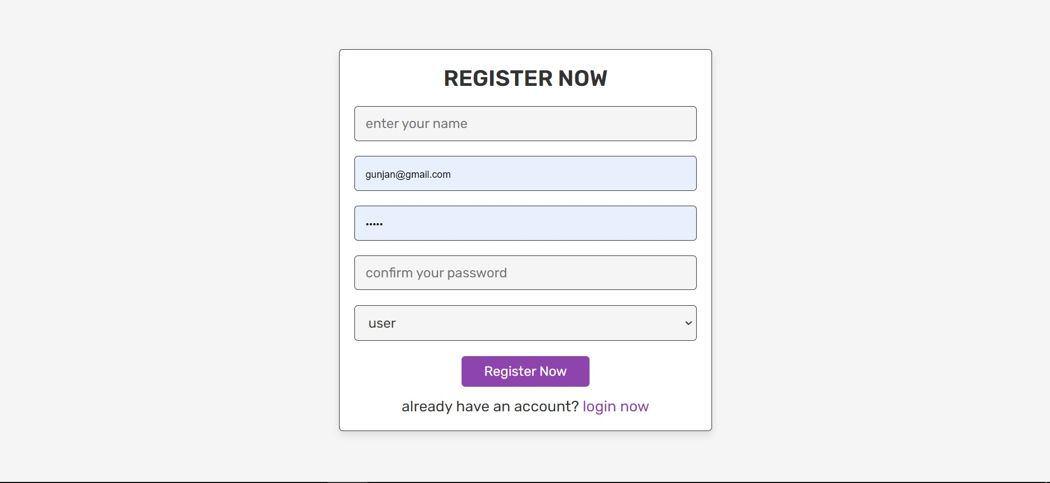
Register Page The "Register" page allows users to create accounts by entering their name, email, and password. Users can specify their role as either a regular user or an admin during registration, defining access levels and permissions accordingly.

Slide 7
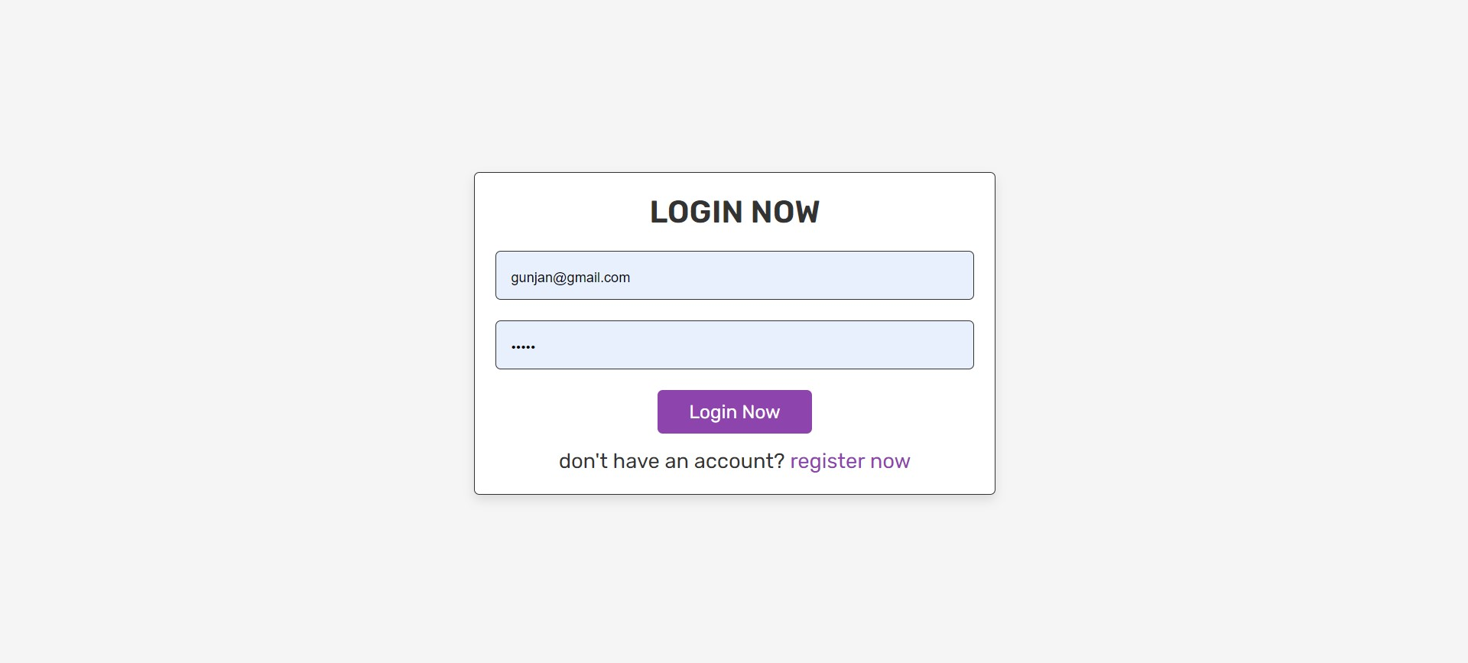
Login Page

Slide 8
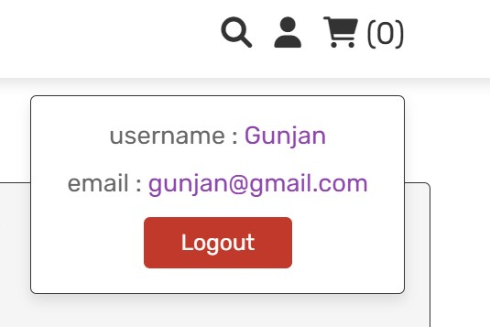
A user profile displays personalized information about a user, such as name, contact details, and preferences. The username is a unique identifier used for login and identification purposes within the system.

Slide 9
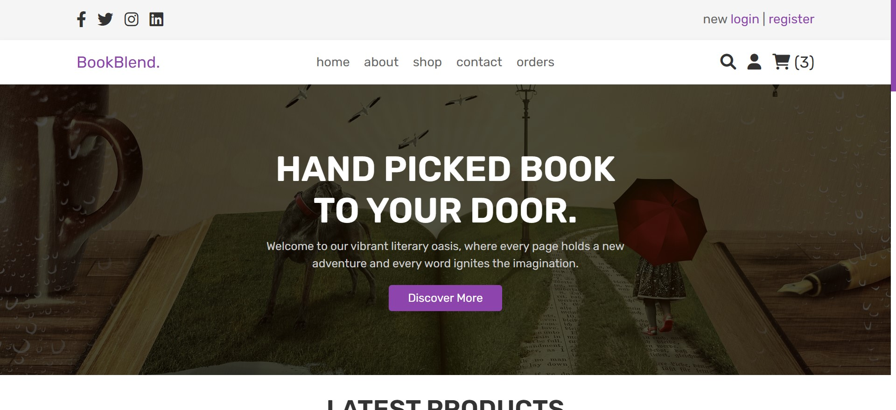
Home Page The homepage features a navigation bar with links to essential sections: Home for site introduction, About for company details, Shop to browse books, Contact for inquiries, and Orders to track purchases. This layout ensures easy access to key areas of the website for seamless user navigation.

Slide 10
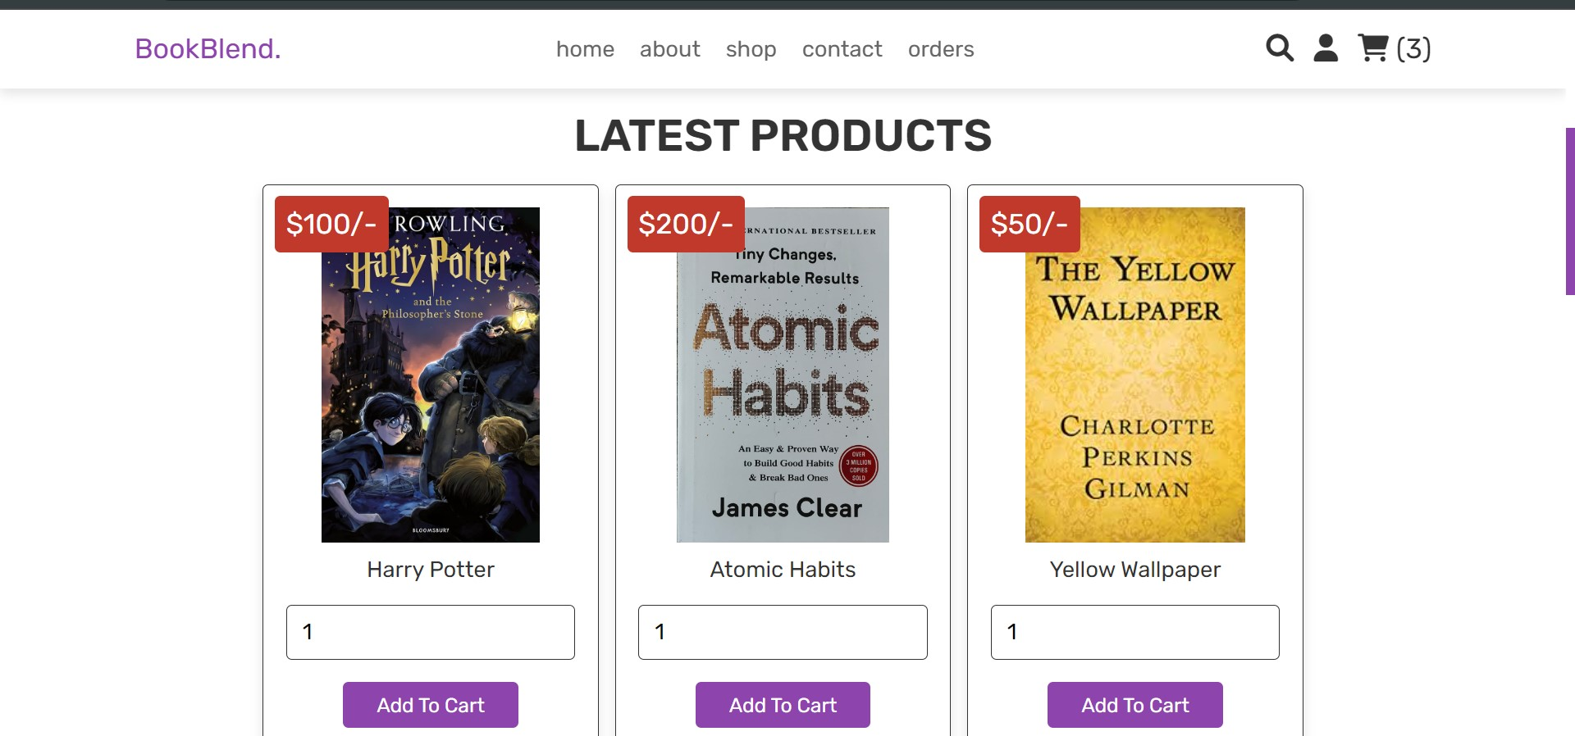
The homepage features a "Latest Products" section displaying new arrivals or featured items with book covers and brief descriptions. This highlights fresh additions, enticing visitors to explore and potentially make purchases.

Slide 11
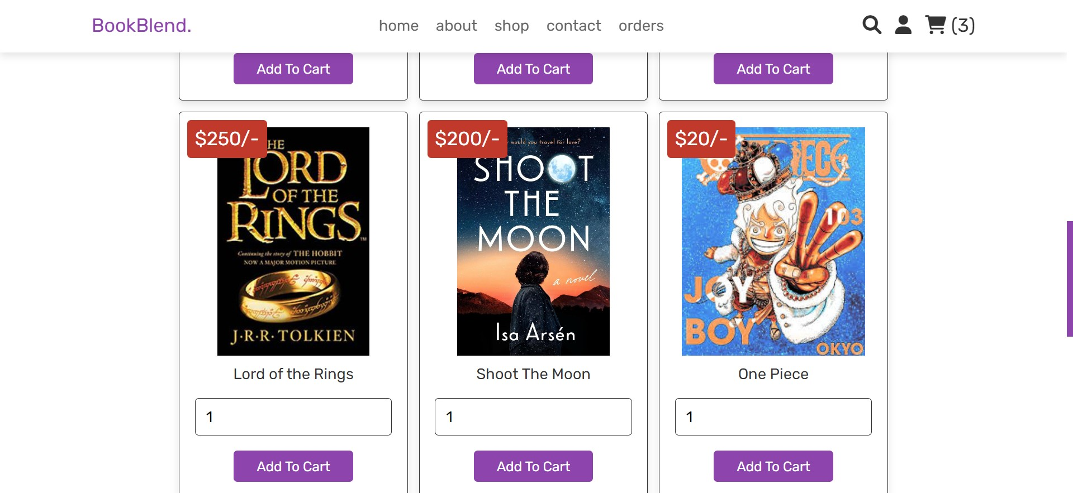
Latest Products

Slide 12
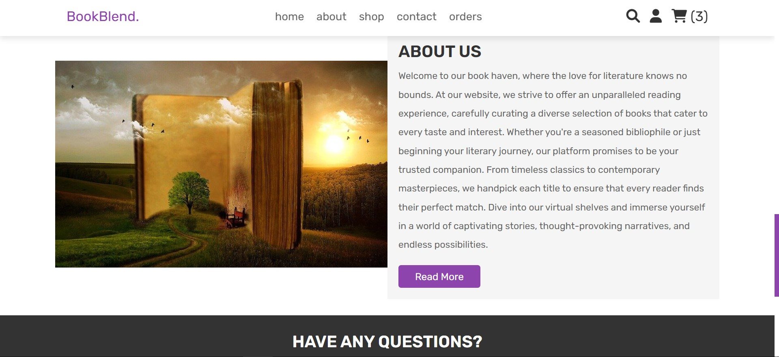
The "About Us" section on the homepage provides insight into our company's mission, values, and history. Learn about our dedication to promoting literature and enhancing the book-buying experience for all readers.

Slide 13
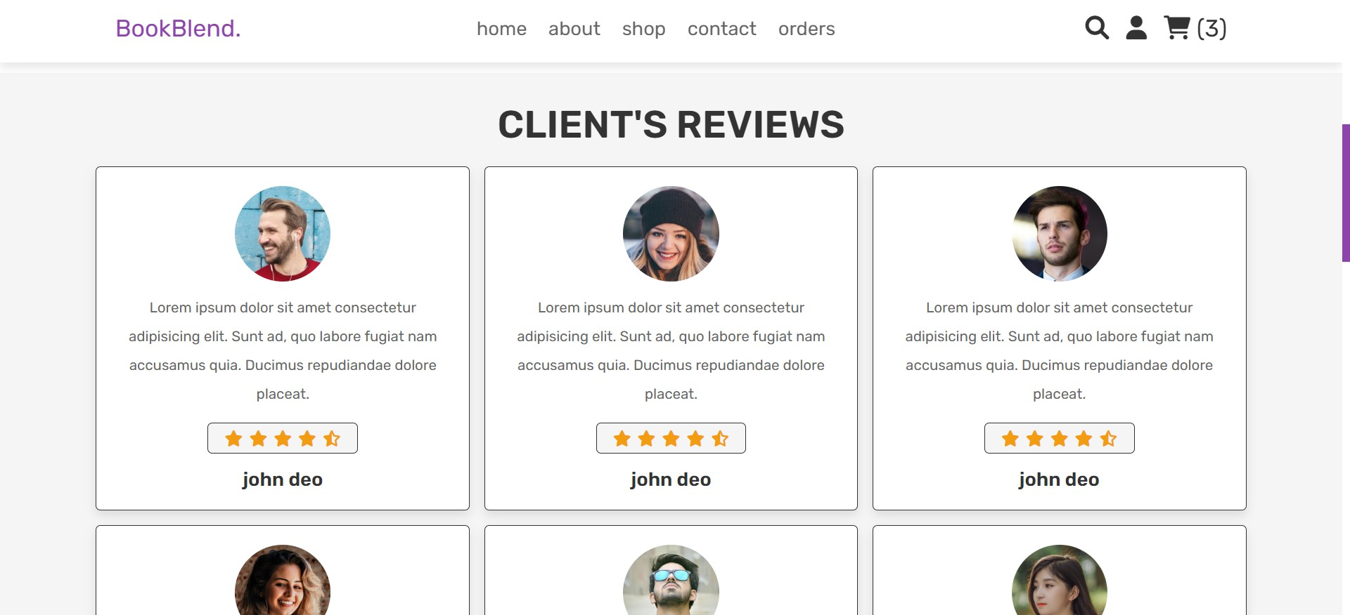
Client reviews Client reviews are valuable feedback from customers about their experience with a product or service. They provide insights into satisfaction levels, highlight strengths or areas for improvement, and influence purchasing decisions for potential customers.

Slide 14
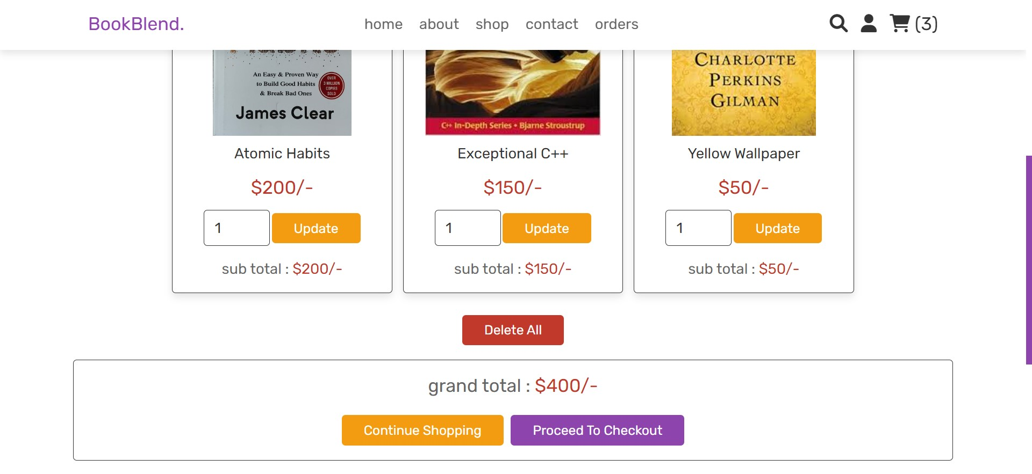
The "Add to Cart" functionality allows users to select items for purchase, accumulating a total price based on selected products. This feature streamlines shopping by summarizing costs and facilitating checkout for a seamless shopping experience.

Slide 15
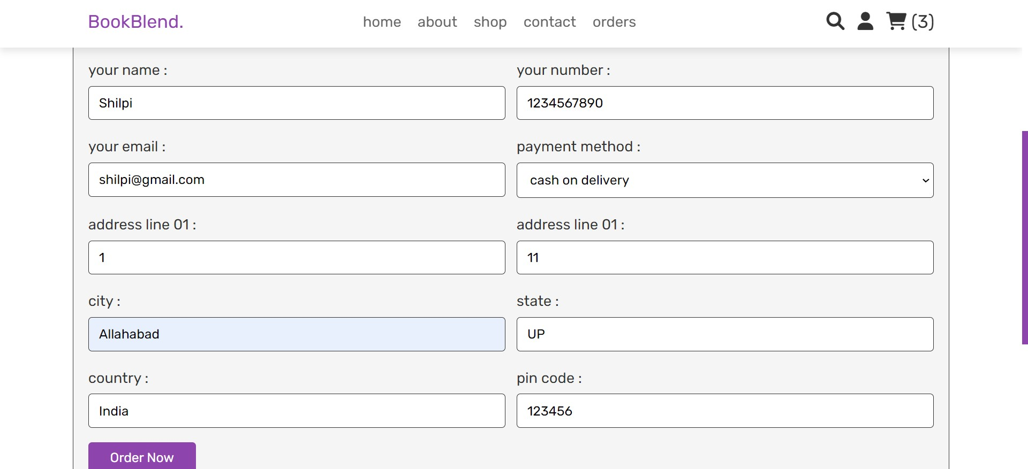
Orders Details Order details include user's shipping address, contact information, and selected items. This information is crucial for processing and delivering orders accurately.

Slide 16
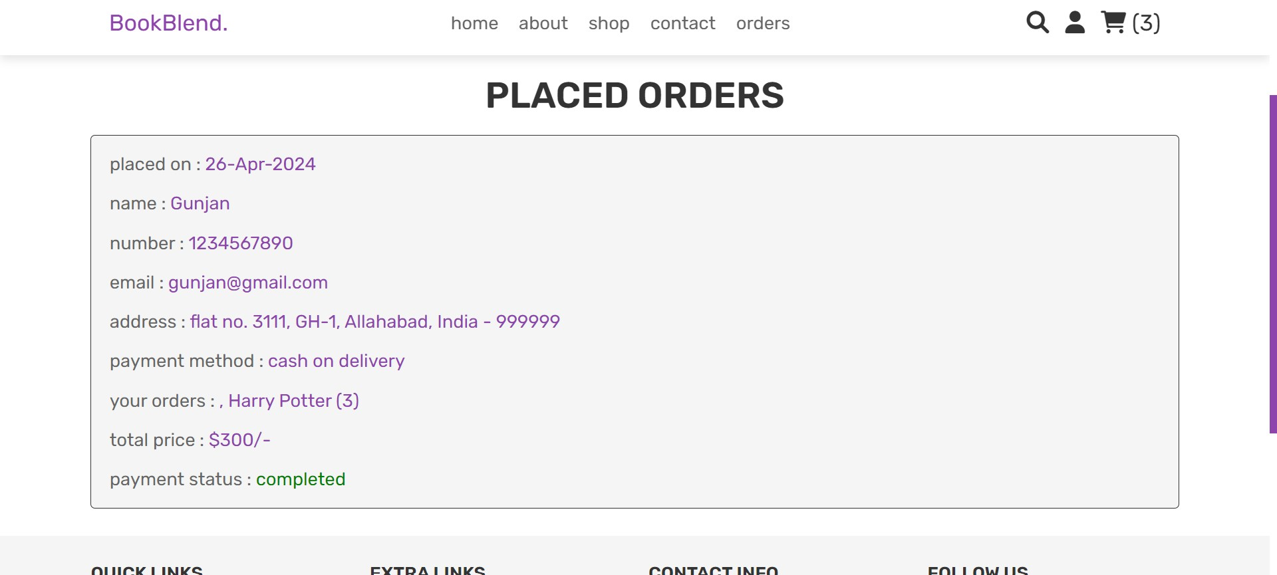
Placed orders Placed orders detail purchase information, including selected items, quantities, total cost, and shipping details. Users can track order status and receive confirmation emails upon purchase completion. This transparency ensures a smooth shopping experience and customer satisfaction.

Slide 17
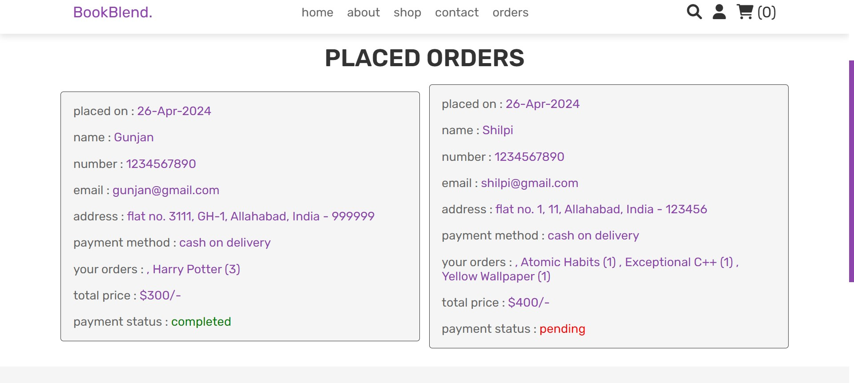
Placed orders At Admin Site

Slide 18
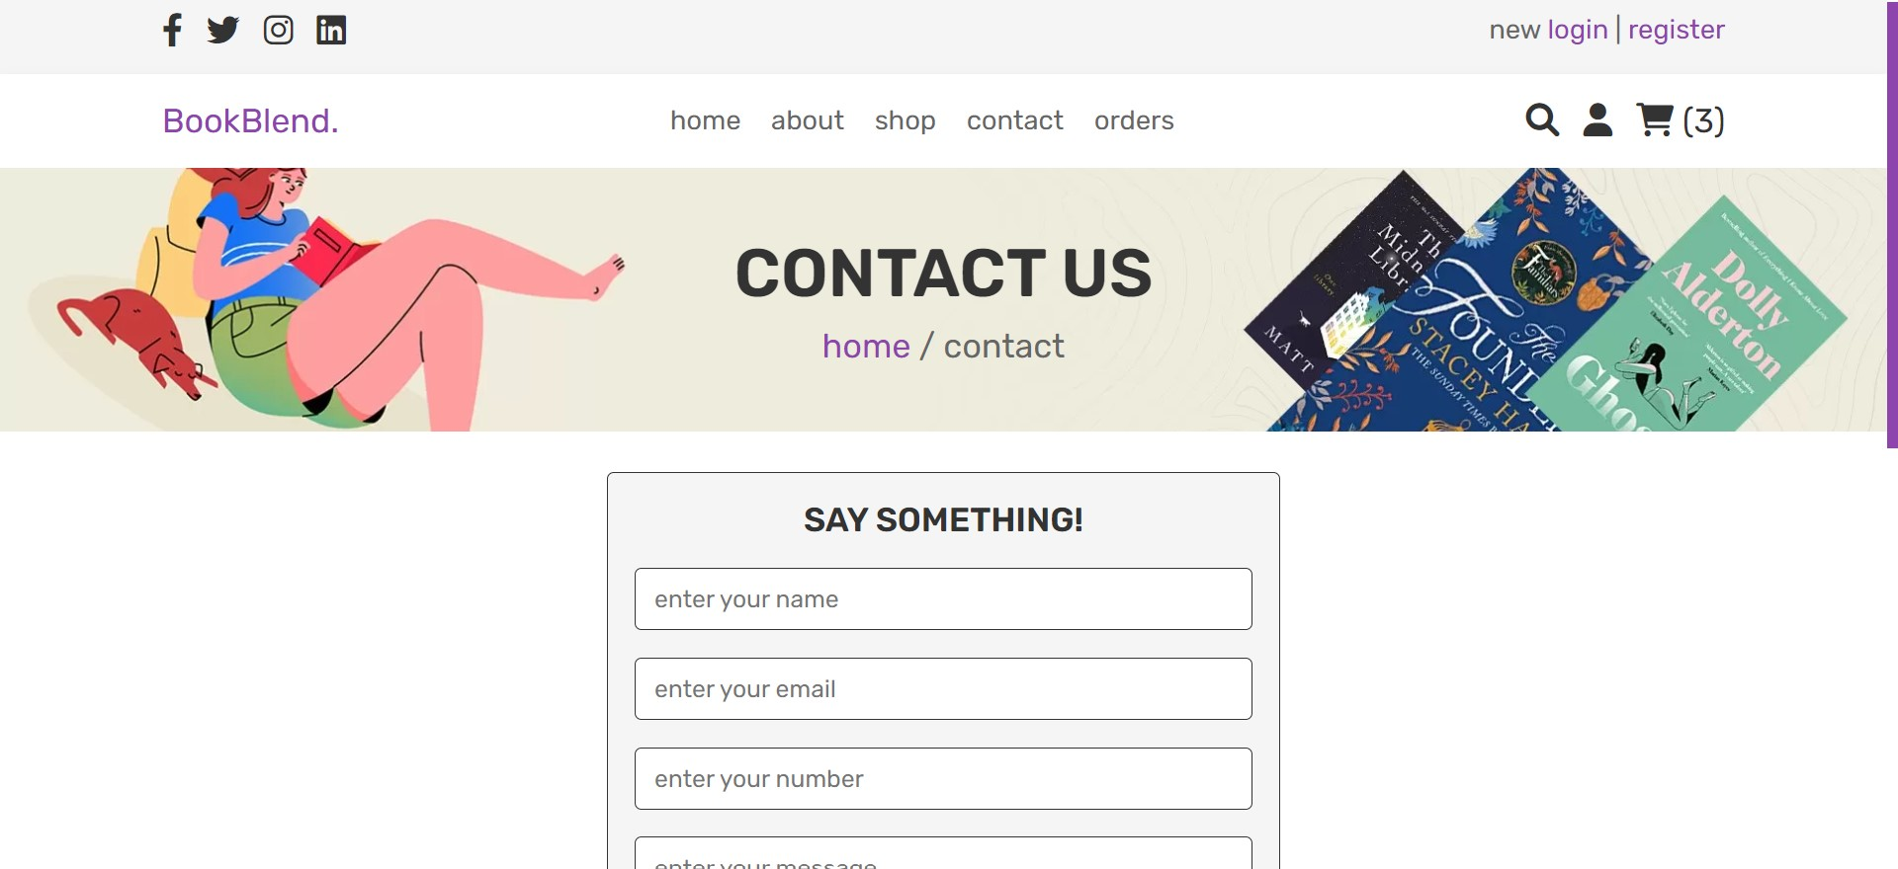
Contact Us The "Contact Us" page allows users to reach the admin with inquiries or feedback through a form. Users input their name, email, subject, and message. This facilitates direct communication and enhances user engagement and support.

Slide 19
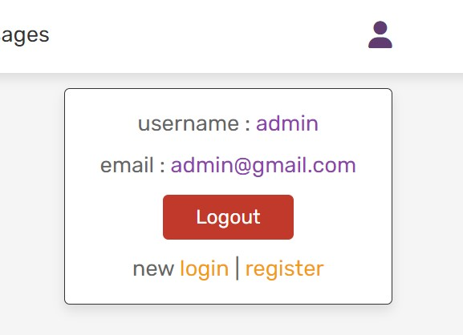
A admin profile displays personalized information about a user, such as name and email . The username is a unique identifier used for login and identification purposes within the system.

Slide 20
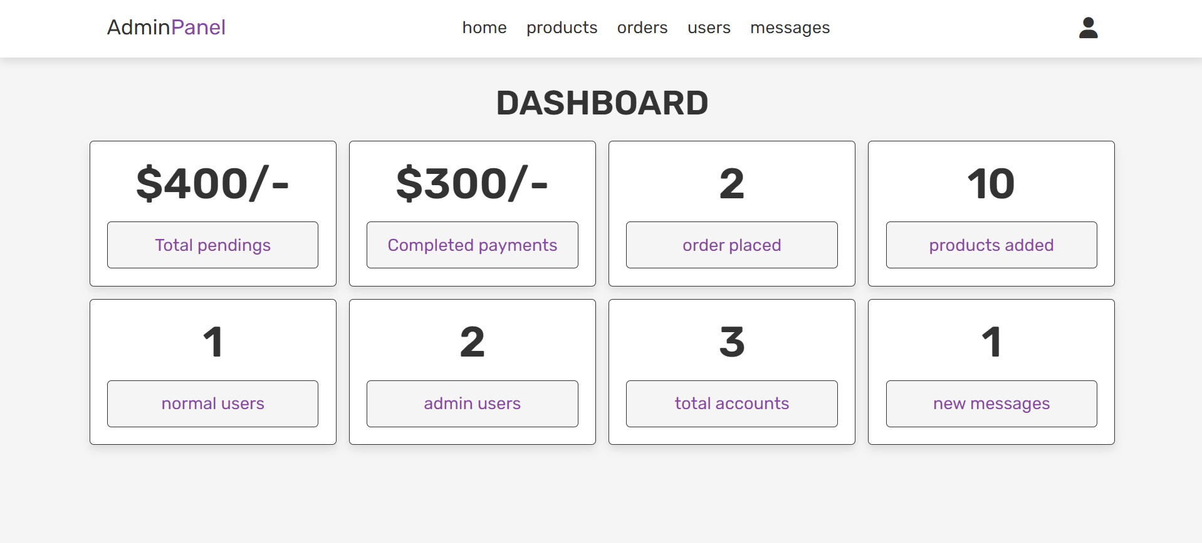
Dashboard The dashboard is an administrative hub showing details like total pendings , completed payments, order placed, products added etc.

Slide 21
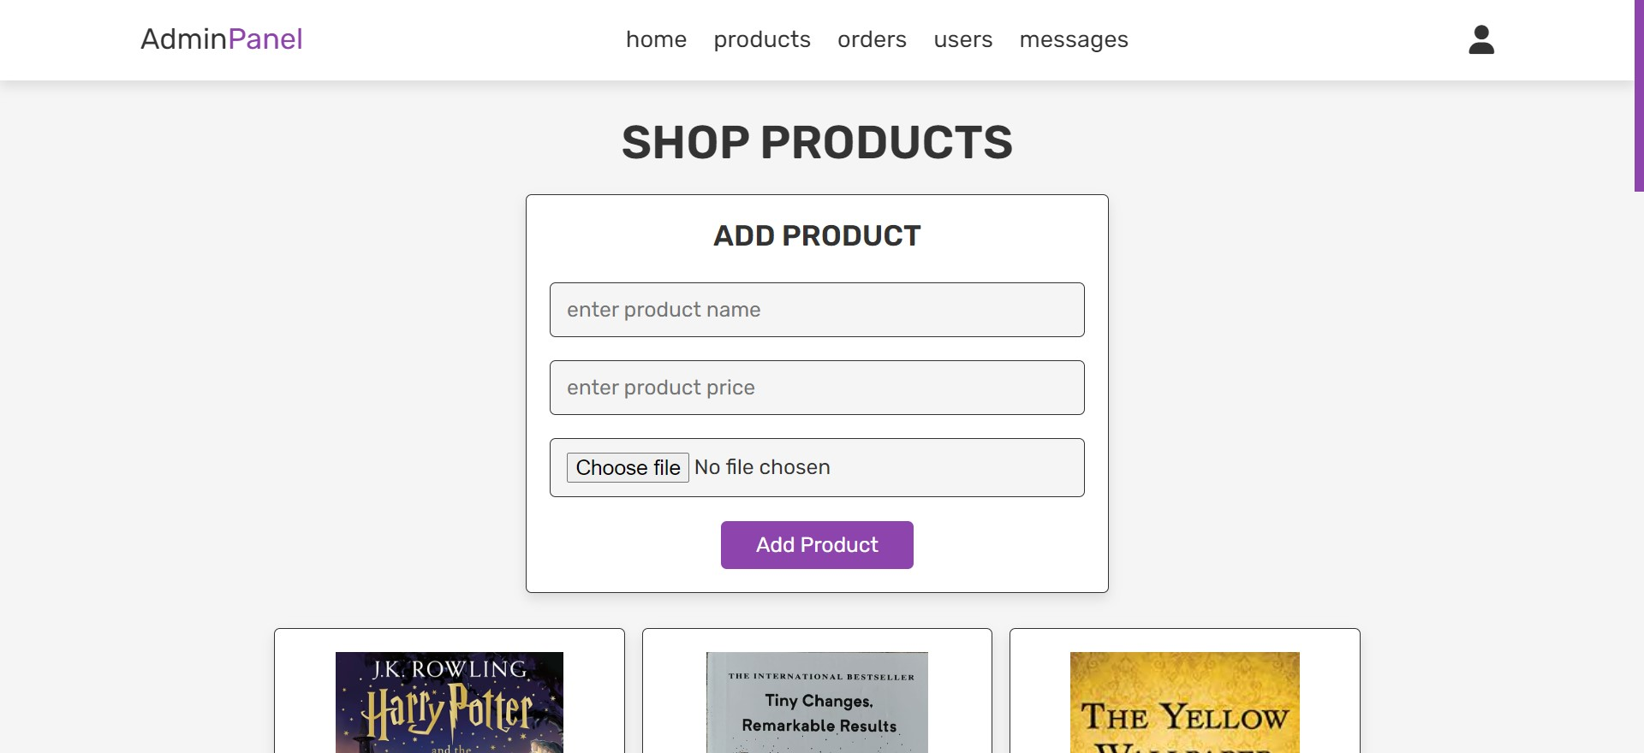
Add Products Admin can add products via the "Admin Dashboard" by entering book details such as title and price. This feature enables efficient management of the website's inventory, ensuring new products are seamlessly integrated into the platform.

Slide 22
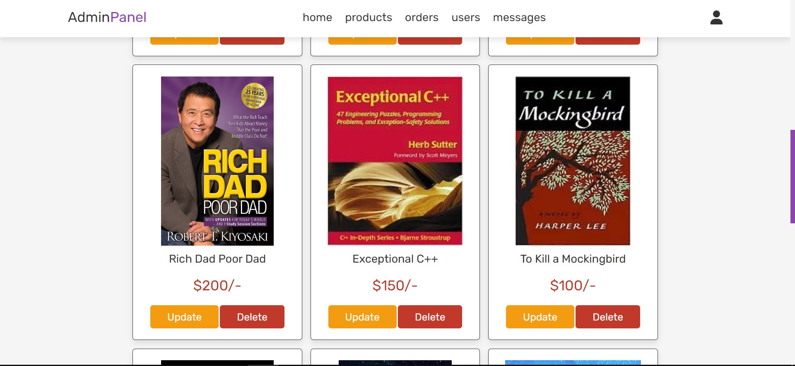
After adding products by admin

Slide 23
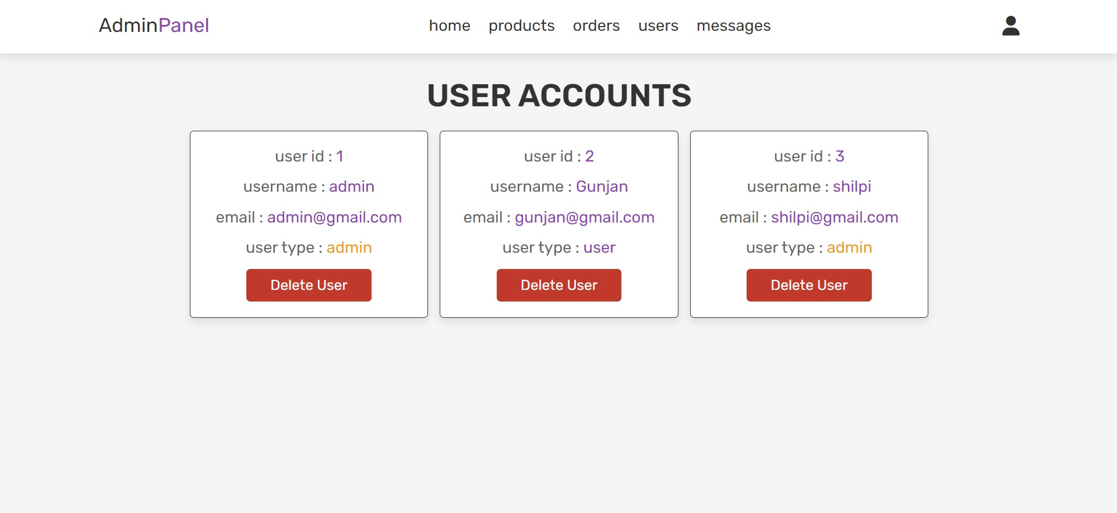
All Users Details The "All Users" section lists registered users with key details like usernames, emails, and roles (admin/user). This view allows administrators to manage user accounts efficiently, ensuring proper oversight and control over the website's user base.

Slide 24
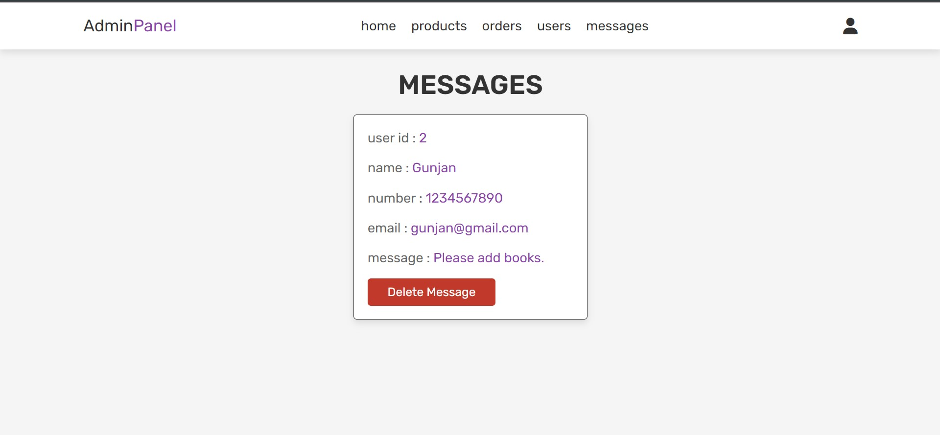
Messages Received By Admin The "User ID Details" section encompasses user-specific information such as username, email, and account preferences. It serves as a centralized location for managing personal details, ensuring users can update and review their profile information conveniently.

Slide 25
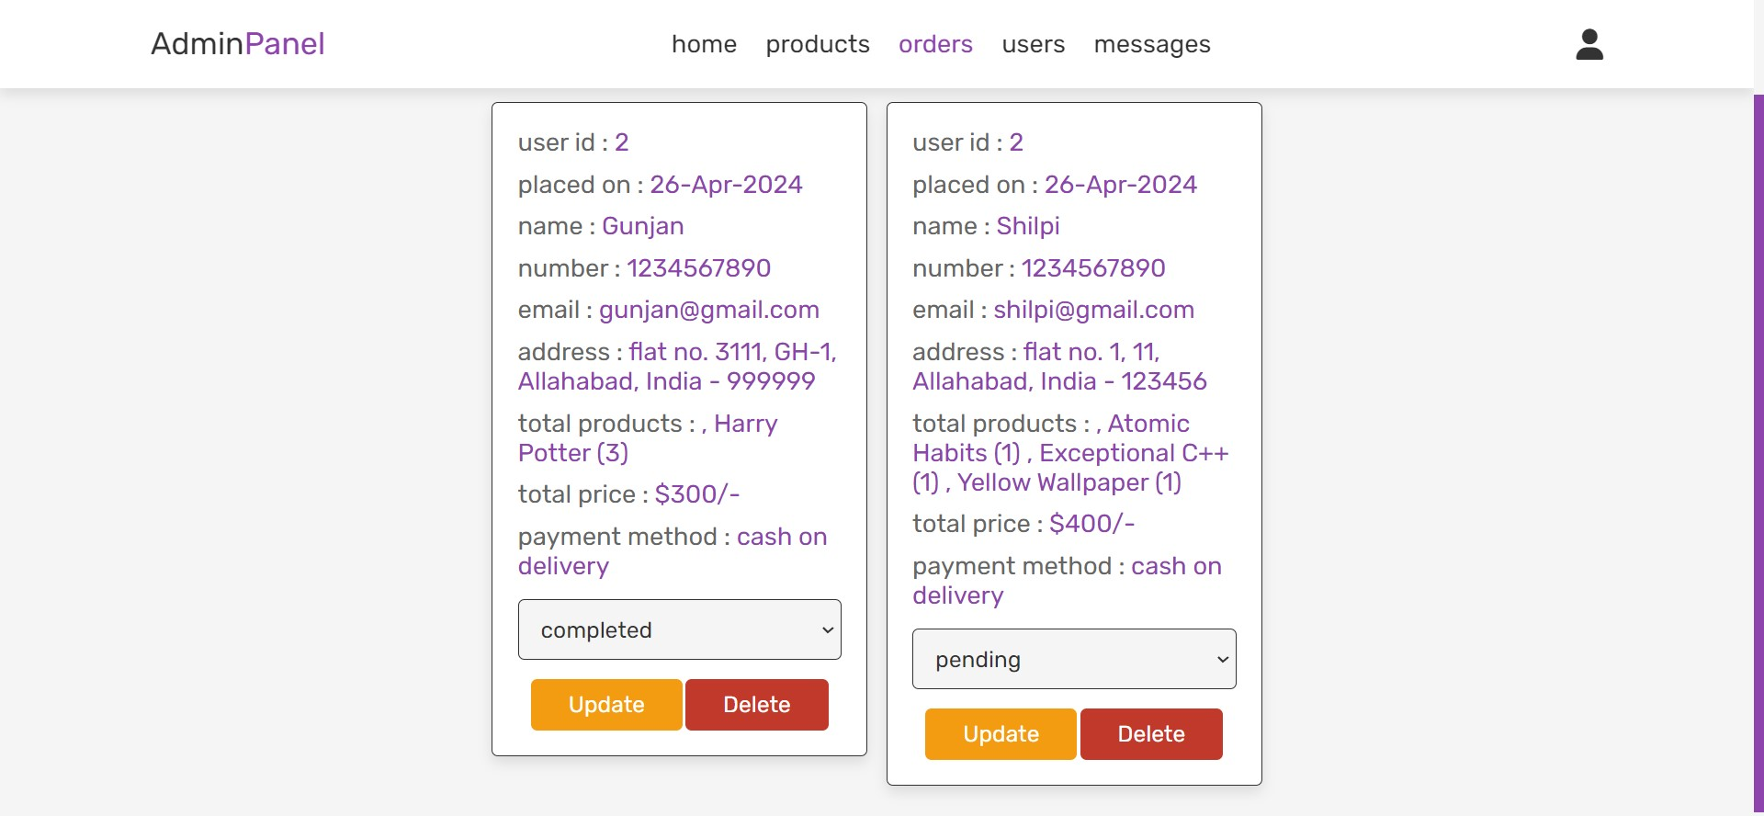
The order status (e.g., completed or pending) indicates the progress of a customer's purchase. "Completed" signifies successful processing and delivery, while "Pending" denotes orders awaiting processing. This feature helps users track their orders and anticipate delivery timelines efficiently.

Slide 26
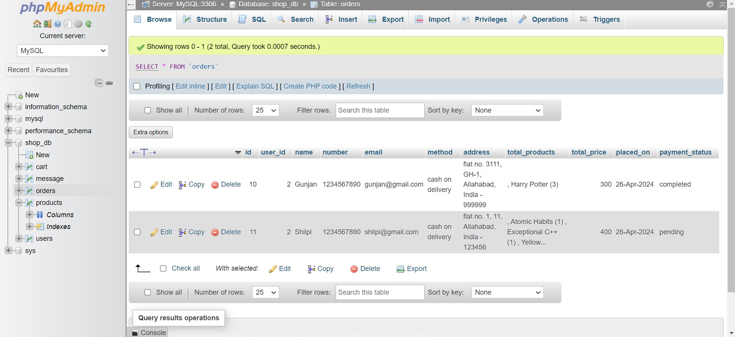
Order Database

Slide 27
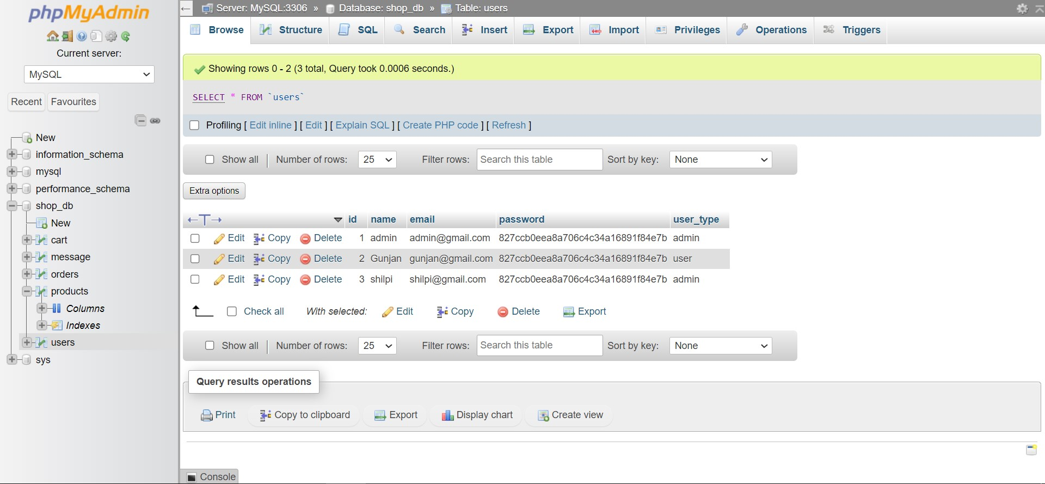
User Database

Slide 28
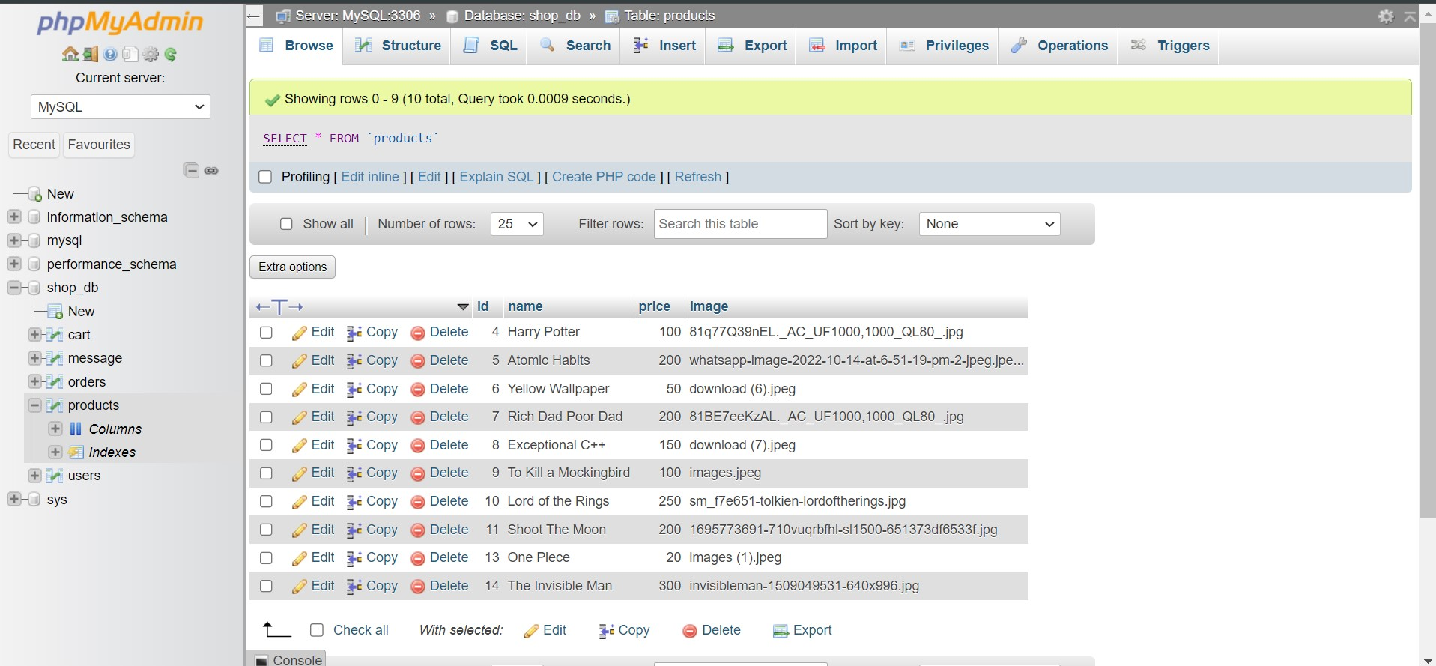
Product Database

Slide 29
Conclusion :
BookBlend achieved a robust e-commerce platform for book enthusiasts. We tackled technical hurdles with PHP and MySQL, prioritized user security, and optimized UI/UX.
This project enhanced our skills and teamwork. Future plans include refining features based on feedback and applying our expertise in real-world applications.

